Slide 1

Big Data Business Case:
Telemarketing Campaign Analysis
Team Members
Rutuja Bhagatsing Kadam
Mariana Reyes
Maria Paula Rodriguez
Daniel Arantes Ventura
Mugdha Vivek Bhatwadekar

Slide 2

Agenda
Business problem overview
Client base analysis
Campaign results analysis
Recommendations

Slide 3
Business Case
Our client is a banking institution located in Portugal that is interested in increasing the number of subscribers to their bank term deposit.
A term deposit is a type of deposit account held at a financial institution where money is locked up for some set period of time.
The institution performed a marketing campaign, mainly over the phone to promote the long-term deposits with attractive interest rates. However, the campaign did not achieve the expected goals.
Our analysis aims to optimize their marketing efforts by understanding what happened with the previous campaign and providing recommendations that generate a conversion rate of 20% for future campaigns.
To summarize the analysis, the team will be delivering a dashboard built in R Shiny

Slide 4
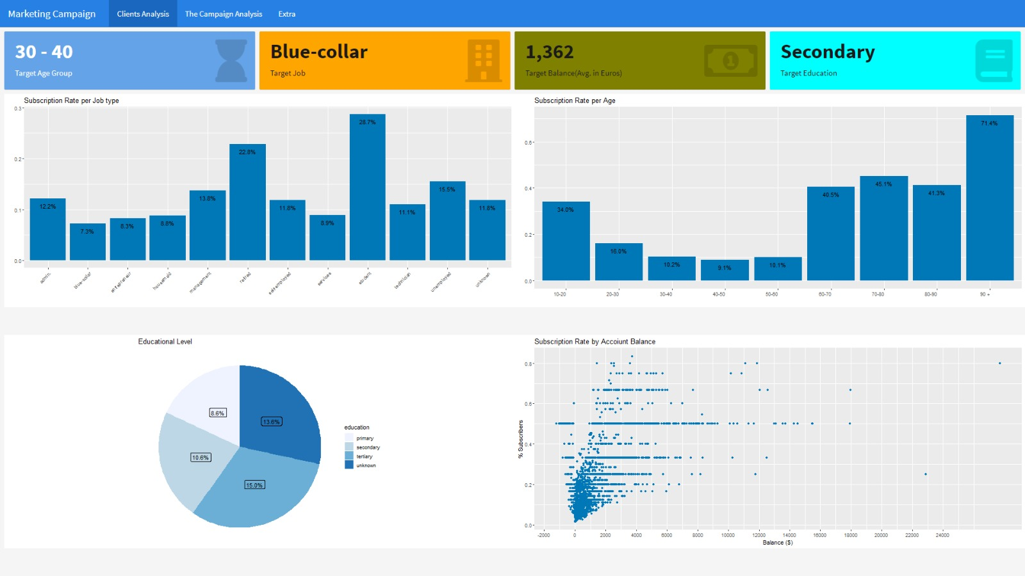

Slide 5
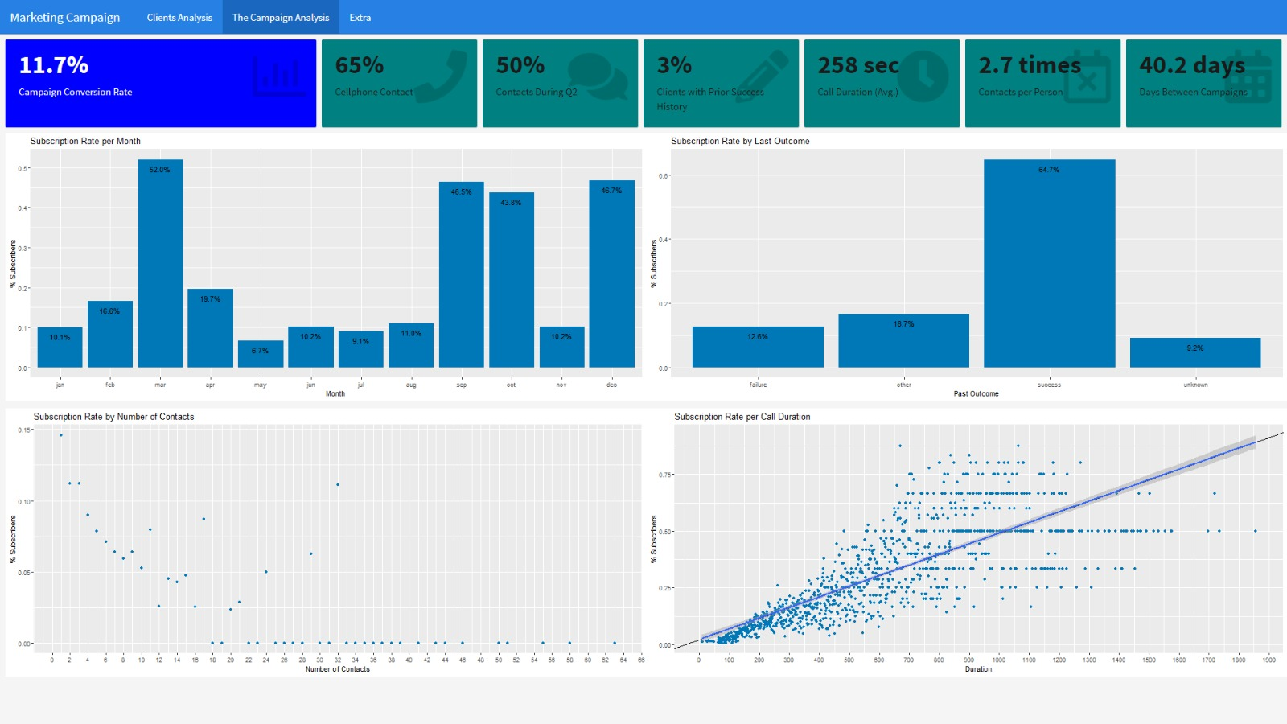

Slide 6
Conclusion & Recommendations
There is a huge opportunity to increase the subscriber base by promoting the product among people over 60 years old that are retired.
Customers with high-balance accounts have a tendency to respond well to this bank term deposit offer.
Given the fact that blue collars were the biggest group targeted and the one with the lowest average account balance. We recommend creating a bank term deposit that better fits the needs of blue-collar customers. For example: Increase flexibility in the terms and the availability to withdraw their funds at any time.
Q4 has significantly higher success probability than the other quarters, further research needs to be conducted to understand why and whether it would be wise to target this quarter for the campaigns.
Target clients with previous successful campaigns, there is a 64% probability of success vs. 12.6% for clients with previous history of failed campaigns.
Further investigate causation of higher conversion rate when call duration increases and number of contacts decrease. If causation is confirmed, contacts would need to be limited to 2 in order to prevent conversion rate from dropping.

Slide 7
References
Bank Marketing Data Set. (2012, February 14). UCI Machine Learning Repository. Retrieved November 2, 2022, from https://archive.ics.uci.edu/ml/datasets/Bank+Marketing

